Slide 1
Introduction to Data Science Lecture 6 Exploratory Data Analysis
CS 194 Spring 2014
Michael Franklin
Dan Bruckner, Evan Sparks,
Shivaram Venkataraman

Slide 2
Outline for this Evening
Class Lecture
Exploratory Data Analysis
Hypothesis Testing
Exercise – EDA and HT in Python
(Evan: Tutorial and Lab)
next week: we’ll play with “R”
Review of exercise
Time for Project Group Discussions

Slide 3
Topics Today and Next Time
Exploratory Data Analysis
Data Diagnosis
Graphical/Visual Methods
Data Transformation
Confirmatory Data Analysis
Statistical Hypothesis Testing
Graphical Inference

Slide 4
Descriptive vs. Inferential
Descriptive: e.g., Mean; describes data you have but can't be generalized beyond that
We’ll talk about Exploratory Data Analysis
Inferential: e.g., t-test, that enable inferences about the population beyond our data
These are the techniques we’ll leverage for Machine Learning and Prediction

Slide 5
Examples of Business Questions
Simple (descriptive) Stats
“Who are the most profitable customers?”
Hypothesis Testing
“Is there a difference in value to the company of these customers?”
Segmentation/Classification
What are the common characteristics of these customers?
Prediction
Will this new customer become a profitable customer? If so, how profitable?
adapted from Provost and Fawcett, “Data Science for Business”

Slide 6
Applying techniques
What models/techniques to use depends on the problem context, data and underlying assumptions.
e.g., Classification problem with binary outcome? -> logistic regression, Naïve Bayes, …
e.g., Classification problem but no labels?
-> Perhaps use K-means clustering

Slide 7
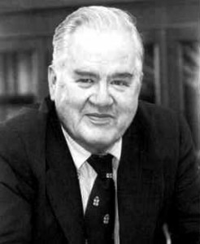
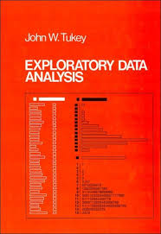
Exploratory Data Analysis 1977
Based on insights developed at Bell Labs in the 60’s
Techniques for visualizing and summarizing data
What can the data tell us? (in contrast to “confirmatory” data analysis)
Introduced many basic techniques:
5-number summary, box plots, stem and leaf diagrams,…
5 Number summary:
extremes (min and max)
median & quartiles
More robust to skewed & longtailed distributions

Slide 8
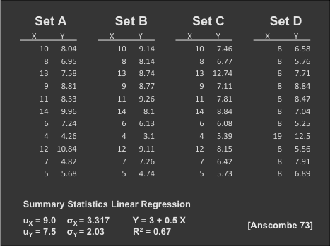
The Trouble with Summary Stats

Slide 9
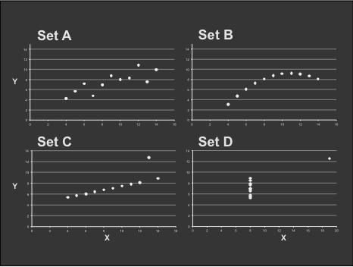
Looking at Data

Slide 10
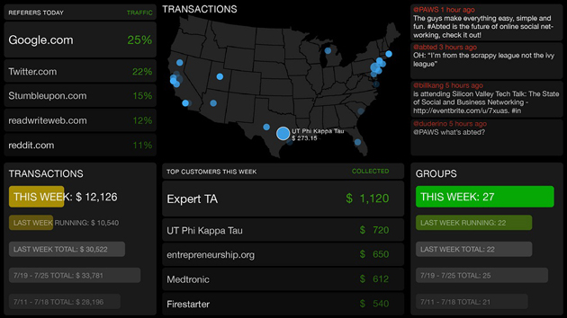
Data Presentation
Dashboard

Slide 11

Data Presentation
Data Art

Slide 12
Chart types
Single variable
Dot plot
Jitter plot
Box plot
Histogram
Kernel density estimate
Cumulative distribution function
(note: examples using qplot library from R)
Chart examples from Jeff Hammerbacher’s 2012 CS194 class

Slide 13

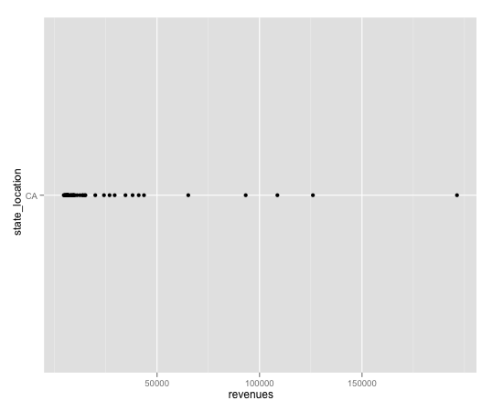
Chart types
Dot plot

Slide 14
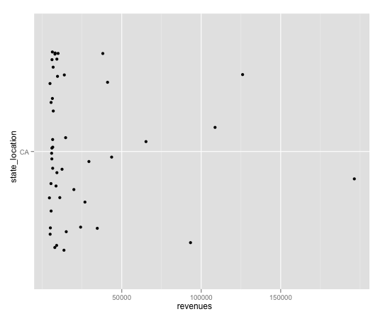
Chart types
Jitter plot

Slide 15
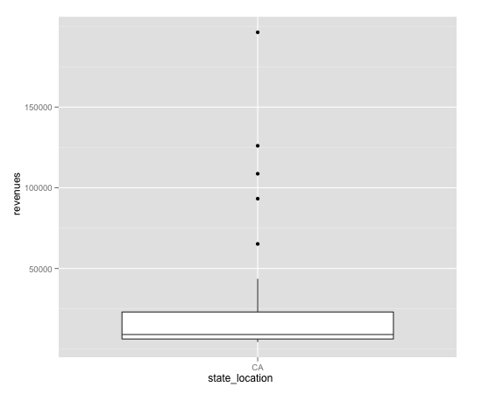
Chart types
Box plot

Slide 16
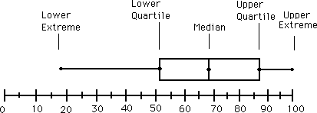
Chart types
Box plot

Slide 17
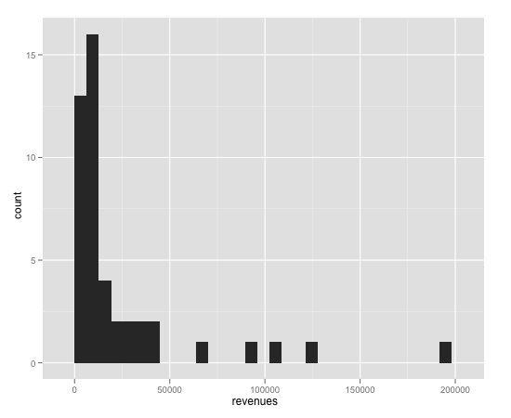
Chart types
Histogram

Slide 18
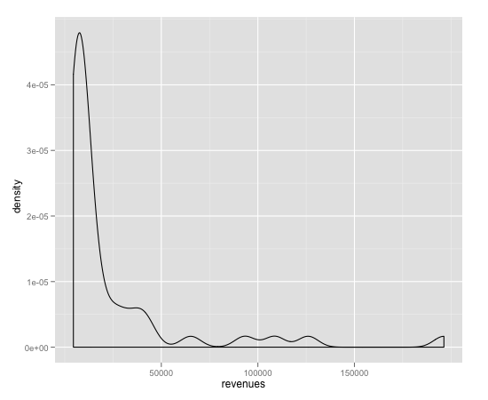
Chart types
Kernel density estimate

Slide 19
Chart types
Histogram and Kernel Density Estimates
Histogram
Proper selection of bin width is important
Outliers should be discarded
KDE
Kernel function
Box, Epanechnikov, Gaussian
Kernel bandwidth

Slide 20
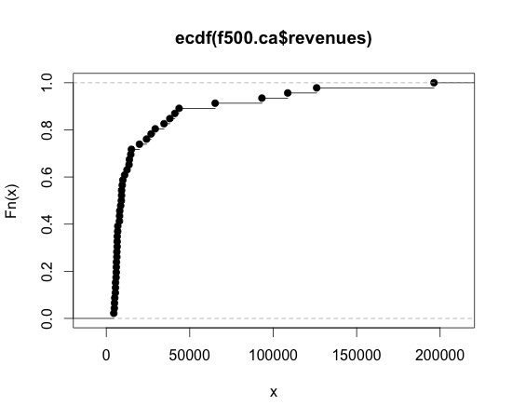
Chart types
Cumulative distribution function

Slide 21
Chart types
Two variables
Scatter plot
Line plot
Log-log plot
Cut-and-stack plot
Pairs plot

Slide 22
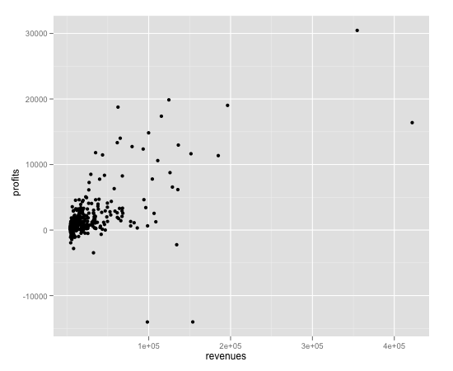
Chart types
Scatter plot

Slide 23
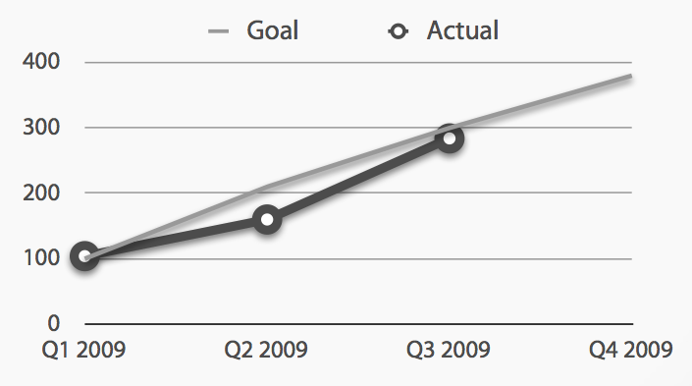
Chart types
Line plot

Slide 24
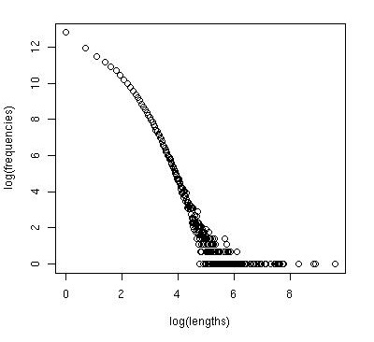
Chart types
Log-log plot

Slide 25
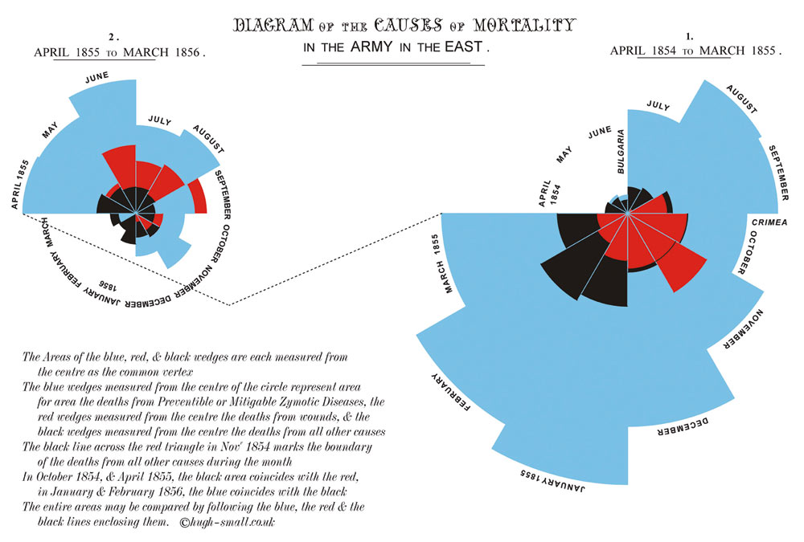
Chart types
Coxcomb plot
Notes:
Atrributed to Florence Nightingale

Slide 26
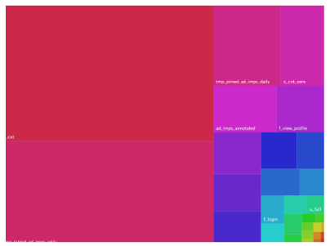
Chart types
Treemap

Slide 27
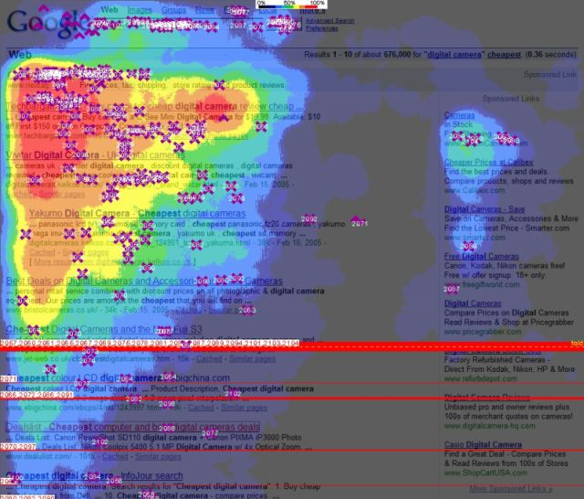
Chart types
Heatmap

Slide 28
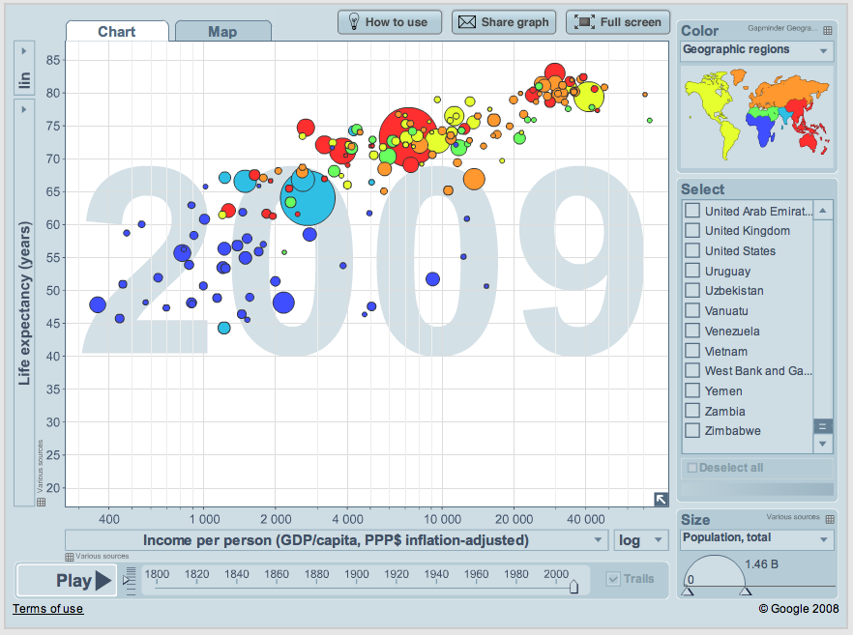
Chart types
Gapminder

Slide 29
The Need for Models
“All models are wrong, but some models are useful.” George Box
Data represents the traces of the real-world processes.
Two sources of randomness and uncertainty:
1) those underlying the process themselves
2) those associated with the data collection methods
To simplify the traces into something more comprehensible you need:
mathematical models or functions of the data -> Statistical estimators

Slide 30
More on Models
N is size of population
n is sample size (subset of the population)
Getting the subset (i.e. sampling) can introduce "bias" leading to incorrect conclusions

Slide 31
Probability Distributions
Natural processes tend to generate measurements whose empirical shape could be approximated by mathematical functions with a few parameters that could be estimated from the data.

Slide 32
Note on ML Algos vs. Stat Models
Techniques and underlying concepts in common
Difference in goals/use:
ML Algos – goal: predict or classify with high accuracty.
basis of many data products
Models – get at the underlying generative process
“Black box” vs. “White box”
Dealing with uncertainty (at the heart of stats)
Distributions vs. non-parametic approaches

Slide 33
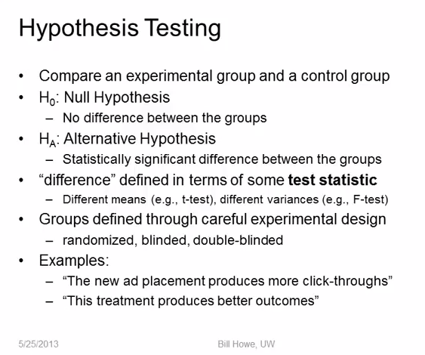

Slide 34
More on Hypothesis Testing
Null Hypothesis is given the benefit of the doubt (e.g., innocent until proven guilty).
Alternative Hypothesis directly contradicts the Null Hypothesis
"Step 1: State the hypotheses."
"Step 2: Set the criteria for a decision."
"Step 3: Compute the test statistic."
"Step 4: Make a decision."

Slide 35
p Value
A p value is the probability of obtaining a sample outcome, given that the value stated in the null hypothesis is true.
In many cases: when the p value is less than 5% (p < .05), we reject the null hypothesis
Note this means that 1 out of 20 times we incorrectly reject the null hypothesis
Do “green jelly beans cause acne?” (see XKCD)

Slide 36
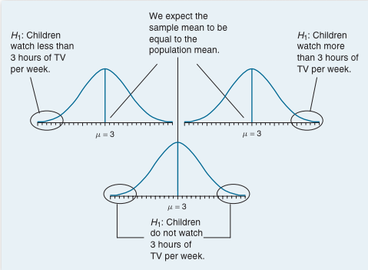
From G.J. Primavera, “Statistics for the Behavioral Sciences”

Slide 37
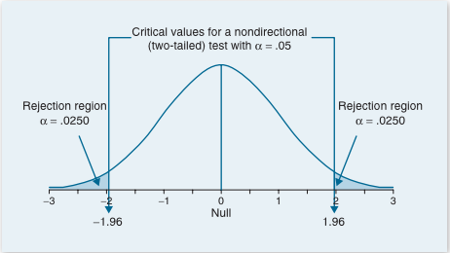
Two-tailed Significance
From G.J. Primavera, “Statistics for the Behavioral Sciences”
When the p value is less than 5% (p < .05), we reject the null hypothesis

Slide 38
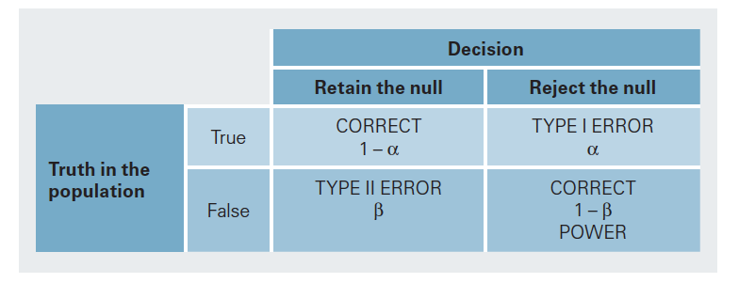
Hypothesis Testing
From G.J. Primavera, “Statistics for the Behavioral Sciences”

Slide 39
Are Two Sets of Data Really Different?
Null Hypothesis: The differences we see are due to “chance”
For Small Sample sizes: use T-test
We’ll do this next in the lab.

Slide 40
Some Notes on the Class
3/17 Intro to Supervised Learning
HW2 coming out tomorrow night
Due after Spring Break but do it before!
FINAL PROJECTS
Group size = 3
What’s expected – find data, build a COOL Data Product, integration & viz or good reason why not
Schedule:
Groups Formed
1-2page proposal DUE 3/11 Midnight
Midway review meeting with Prof or GSIs following 1-2 weeks
Final Presentation (Posters and/or Lightning talks)
Final Report

